Slide 1

Diagnostic Radiography
Workforce UK Census
2022
207 Providence Square,
Mill Street, London SE1 2EW
www.sor.org

Slide 2

 |  |  | Slide
1. | Executive Summary |  | 5
2. | Methodology |  | 7
3. | Profile of respondent workforce size |  | 8
4. | Shape of workforce by Agenda for Change band |  | 9
5. | Vacancy rate |  | 12
 | 5.1 | Current vacancy rate | 12
 | 5.2 | Current vacancy rate by UK country and region | 13
6. | Establishment by modality |  | 14
7. | Long-term absence rate |  | 17
 | 7.1 | Long-term absence rate by AfC band | 17
 | 7.2 | Long-term absence rate by year | 19
 | 7.3 | Long-term absence rate by sector | 20
8. | Age by AfC band and sector |  | 21
9. | Leavers |  | 22
 | 9.1 | Turnover | 22
 | 9.2 | Reasons for leaving | 23
10. | International recruitment |  | 24
11. | Apprenticeships (NHS in England) |  | 25
Contents
2
Diagnostic Radiography Workforce UK Census 2022
207 Providence Square, Mill Street, London SE1 2EW. www.sor.org

Slide 3
 |  | Slide
12. | Return to practice | 26
13. | Registration status of band 5 or higher clinical staff | 27
14. | Supporting professional activities | 28
15. | Postgraduate training | 30
16. | Support workforce | 31
17. | Advanced and consultant practice | 32
18. | Agency staff | 33
19. | References | 34
20. | Downloads | 35
3
Diagnostic Radiography Workforce UK Census 2022
207 Providence Square, Mill Street, London SE1 2EW. www.sor.org

Slide 4
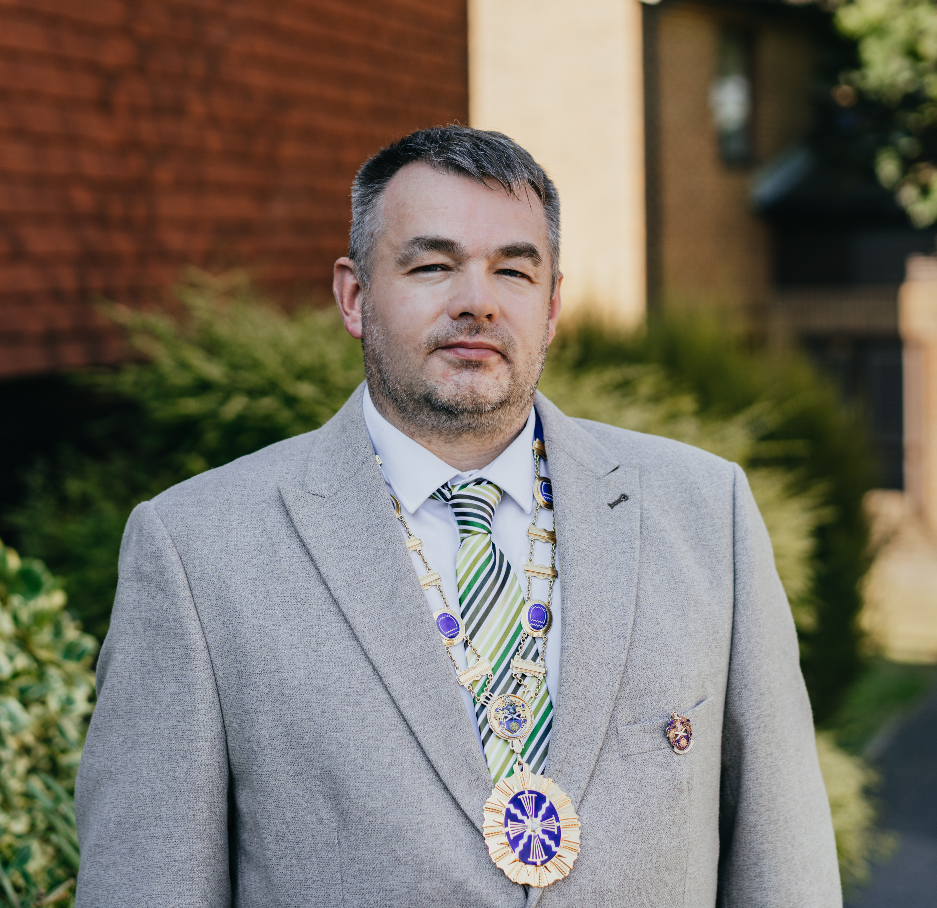

Each year the Society of Radiographers (SoR) undertakes a UK-wide diagnostic radiography workforce census to gain intelligence about the clinical imaging radiography workforce.
The census collection, as ever, was taken at a time when services were reporting significant pressures on staff, and we would like to express our sincere thanks to those services that submitted their data.
The spotlight remains on imaging, and the whole imaging workforce, throughout the four UK home nations. So for the second year running the census includes data on the support workforce.
We have reported on data submitted by region and by devolved country when possible. Data collected from independent (non-NHS) sector providers has been separated out from NHS providers’ data where appropriate.
The Society of Radiographers (SoR) is the professional body and trade union for the whole of the radiographic workforce, and we collect this data in order to support and advance the interests of our profession, for example as evidence to the pay review body. We collect data that allows recognition of the breadth of professional activities carried out by our workforce over and above the activities of imaging acquisition and reporting, allowing us to provide evidence to support workforce modelling, education and training requirements across the whole of the United Kingdom. It is of note that our report and data are accessible to all.
Overall diagnostic radiography vacancy rates remain high, with average turnover rates reported at 10.2%. It is encouraging to see the increase in apprenticeship posts in England and an increase in international recruitment.
Foreword
Respondents however report low morale and, due to vacancy rates, little time to support staff in continuing professional development (CPD) and audit activities. There is recognition that training and development in advanced practice is key to recruitment and retention but is not possible due to the lack of workforce for staff to backfill posts. The rise in apprenticeships is welcomed but there needs to be an increase in practice educator roles. These are clear indicators that the radiographic workforce needs to grow significantly.
President, Society and College of Radiographers
Dave Pilborough
4
Diagnostic Radiography Workforce UK Census 2022
207 Providence Square, Mill Street, London SE1 2EW. www.sor.org

Slide 5
These are the main findings:
The average number of diagnostic radiography establishment staff by whole-time equivalent (WTE) per respondent is 118.8. For NHS respondents this is 131.9 and for non-NHS respondents 67.4.
Of the 59 respondents to a question on current vacancies, 52 (89%) reported vacant diagnostic radiography workforce posts.
The average current UK vacancy rate across respondents was 12.8% on the census date (1 November 2022). The average current vacancy rate varies by UK country – 12.8% in England, 7.5% in Scotland and 8.3% in Wales. Only one response was received from Northern Ireland, so that country’s average vacancy rate is not given. In England, the NHS regions of London, Midlands, North East and Yorkshire and South East have vacancy rates greater than 12%. Vacancy rates were not calculated for NHS regions from which fewer than five responses were received.
The prevailing trend regarding the workforce profile by imaging modality remains unchanged from last year’s census, with the majority of Agenda for Change (AfC) band 5 practitioners employed in X-ray. There is growth among AfC band 6 practitioners employed in computed tomography (CT), magnetic resonance imaging (MRI), fluoroscopy and nuclear medicine. Most ultrasound practitioners are at AfC band 7. The majority of AfC band 4 assistant practitioners are employed in X-ray, with a growing number in MRI.
The average percentage of postholders absent due to long-term sickness rose from 1.6% to 2.6% between 2019 and 2022. This is the primary factor behind the total long-term absence rate increase from 4.1% to 5.7% over the same period. NHS respondents reported a higher long-term absence rate (6.1%) than non-NHS respondents (2.3%), mainly due to differences in the long-term sickness absence rate (2.9% versus 0.8%) and parental leave absence rate (2.8% versus 1.5%).
Respondents told us that the overall percentage of their workforce who are aged 60 years and over is 4.7%. In the NHS the percentage is 4.9% and among non-NHS providers it is 4.3%.
The average diagnostic radiography workforce turnover reported by respondents in the last year is 10.21%. The highest turnover rates are seen at bands 2 and 5. The two main reasons respondents gave for postholders leaving are career development in another NHS imaging department and retirement. The percentage of postholders leaving their positions for higher salary opportunities elsewhere has notably increased, rising from 19% in 2019 to 43% in 2022.
Respondents have recruited 8.1% of their headcount internationally over the past year and intend to recruit a further 7.5% in the coming year. The international recruitment drive is largely centred on AfC band 5, band 6 and band 7. By headcount, 14% of band 5 staff were recruited internationally over the past year and a further 18% are expected to be recruited internationally during the coming year. This demonstrates an increase since the previous census, which found 4.1% of respondents’ headcount were recruited internationally between 2020 and 2021 and a further 4.1% planned between 2021 and 2022.
1
Executive
Summary
The Society of Radiographers (SoR) carried out a census of the UK diagnostic radiography workforce between November 2022 and January 2023. The objectives were to establish the structure, nature and vacancy rate of the workforce. In total, 59 medical imaging service providers responded to SoR’s online questionnaire. This report presents an analysis of the census results and compares them with similar censuses carried out in 2019, 2020 and 2021 (see References section of this report).
5
Diagnostic Radiography Workforce UK Census 2022
207 Providence Square, Mill Street, London SE1 2EW. www.sor.org

Slide 6
On average, NHS respondents in England report that 5.5 posts are apprenticeships (by headcount). This is an increase from the 2021 census, when an average of 2.8 apprenticeship posts (by headcount) were reported. The apprenticeship posts with the highest average headcount are diagnostic radiography integrated degree (2.9) followed by healthcare assistant practitioner (1.4).
Two (12.5%) of the 16 respondents to the census return to practice question had supported a return to practice radiographer in the year up to the November 2022 census date.
Respondents reported that, by headcount, 2.2% of clinical staff at AfC band 5 or higher are not registered with the Health and Care Professions Council (HCPC), Nursing and Midwifery Council (NMC), Register of Clinical Technologists (RCT) or similar body. For NHS respondents this percentage is 0.7% and for non-NHS respondents 12.4%.
Respondents reported that at band 7 around 35% of an individual’s time is spent on supporting professional activities. This increases to around 58% at band 8a. Supporting professional activities underpin the delivery of imaging services but are not directly patient-facing. They relate to, for example, leadership, management, picture archiving and communication systems (PACS), quality improvement, quality management, the Quality Standard for Imaging (QSI), research, service development, training and development.
By headcount, 5.5% of respondents’ staff are in postgraduate training, including for a postgraduate certificate (PgCert) or diploma (PgDip) or master’s level qualification. The top six postgraduate training areas, in descending order, are:
Ultrasound
Conventional imaging reporting
Leadership development
Mammography (including reporting, biopsy etc)
CT PgCert/PgDip/master’s
MRI PgCert/PgDip/master’s.
Respondents reported that, by headcount, 23.2% of their diagnostic radiography workforce are in bands 2, 3 or 4 (referred to here as support workers). Data from the 47 NHS respondents to the census question on total headcount shows that support workers make up 22.3% of headcount compared with 28.7% reported by the 12 non-NHS respondents.
By headcount, 8.5% of respondents’ diagnostic radiography workforce are advanced practitioners and 0.8% are consultant-level practitioners. The 47 NHS respondents to this question reported that advanced practitioners are 9.61% of headcount compared with 1.2% reported by the 12 non-NHS respondents. The non-NHS respondents have 0.13% consultant-level practitioners.
As of the November 2022 census date, 76% of respondents were employing some diagnostic radiography and/or sonography agency staff. This percentage has been steady at around 80% for the past five years.
6
Diagnostic Radiography Workforce UK Census 2022
207 Providence Square, Mill Street, London SE1 2EW. www.sor.org

Slide 7
The 2022 workforce census captures data about the diagnostic radiography workforce in the UK on the 1 November 2022 census date. Radiology services managers (or equivalents) were asked to answer the census on behalf of all diagnostic radiography (medical imaging) services in their hospital/workplace or organisation. They were asked to include details of all practitioners in the career framework, from clinical support workers and assistant practitioners through to advanced and consultant practitioners, plus apprenticeship posts (England only) and trainee assistant practitioners. These are referred to collectively as the ‘diagnostic radiography workforce’ in this report. Excluded are clerical workers, clinical scientists, radiotherapy staff and individuals working for third-party managed services where the third party employs the staff. Please note that clinical support workers have been included since the 2021 census.
Respondents were asked to provide the following information:
Their contact details, geographic location, details of the workplaces and medical imaging modalities on behalf of which they were responding
Establishment numbers by AfC band – WTE and headcount
Vacancy numbers by AfC band
Establishment numbers by modality – WTE
Long-term absence numbers by AfC band – career break, long-term sickness, and parental leave
Numbers of staff aged 60 years and over
Number of leavers since 1 November 2021 and reasons for leaving
Number of staff recruited internationally in the past year and plans for international recruitment in the coming year
Apprenticeship posts
Support given to radiographers returning to practice
Number of staff not registered with the HCPC, NMC, RCT or similar body
Time spent supporting professional activities and the nature of those duties
Number of staff in postgraduate training
Number of staff in advanced and consultant practice
Use of agency diagnostic radiographers and sonographers
Both NHS and non-NHS providers were asked to supply their workforce data by AfC band. Non-NHS providers may not use the AfC system so they were asked to refer to the NHS AfC pay bands before responding. This meant all data could be collected and analysed by AfC band.
Data collection was carried out using an online survey tool between November 2022 and January 2023. Email invitations were sent to 147 providers of medical imaging services in the UK (often to more than one individual at the organisation). The census was also promoted via the Society and College of Radiographers (ScoR) publications, website and social media. We received 59 responses, the same number as in the previous census taken in November 2021.
Not every respondent answered every question. The ‘n’ number below each figure in this report indicates how many respondents answered that question in the 2022 census.
Links to the full set of questions for the 2022 census and a spreadsheet of the principal background data for the establishment and vacancy numbers are provided in the downloads section at the end of this report.
2
Methodology
7
Diagnostic Radiography Workforce UK Census 2022
207 Providence Square, Mill Street, London SE1 2EW. www.sor.org

Slide 8

3
Profile of respondent workforce size
Size distribution of census respondents
51% of respondents (both NHS and non-NHS providers) have a diagnostic radiography workforce establishment of less than 60 WTE, as illustrated in Figure 1.
Figure 1: Diagnostic radiography
workforce WTE size distribution of respondents (n=59)
Number of respondents
Diagnostic radiography workforce establishment size WTE
Figure 1

Slide 9
4
Shape of workforce by Agenda for Change band
Average diagnostic radiography workforce WTE per respondent
by Agenda for Change band (NHS and non-NHS)
The average number of diagnostic radiography establishment staff per respondent is 118.5 WTE. Figure 2 illustrates the average number of WTE NHS and non-NHS staff by AfC band. The figure excludes the average of 0.7 WTE staff per respondent for whom it is reported that an AfC band is not applicable to their role.
Figure 2: Average diagnostic radiography workforce WTE by AfC
band – NHS and non-NHS (n=59)
Figure 2

Slide 10
Average diagnostic radiography workforce WTE per respondent
by Agenda for Change band (NHS)
Figures 3 and 4 show the shape of the diagnostic radiography establishment workforces of NHS and non-NHS providers who responded to the 2022 census:
The average establishment size reported by NHS respondents is 131.6 WTE
The average establishment size reported by non-NHS respondents is 67.4 WTE
Figure 3: Average diagnostic radiography workforce WTE by AfC band – NHS (n=47)
Figure 3

Slide 11
Average diagnostic radiography workforce WTE per respondent
by Agenda for Change band (non-NHS)
Figure 4 excludes the 3.4 WTE staff per non-NHS respondent for whom it is reported that an AfC band is not applicable to their role.
Figure 4: Average diagnostic
radiography workforce WTE by
AfC band – non-NHS (n=12)
Figure 4

Slide 12

Current vacancy rate by Agenda for Change band
5
Vacancy rate
5.1
Current vacancy rate
Of the 59 respondents to the census question on current vacancies, 52 (89%) reported vacant diagnostic radiography workforce posts. Vacancy rates are broken down by AfC band in Figure 5.
Figure 5: Current vacancy rate by AfC band (n=59)
The current vacancy rate is defined as the total number of WTE vacancies as a percentage of the WTE establishment number of staff. The average current UK vacancy rate across respondents was 12.8% on the 1 November 2022 census date. This is higher than the average vacancy rate reported in the previous three censuses, which was 9.6% in November 2019, 10.5% in November 2020 and 12.7% in 2021.
Figure 5 illustrates that there are combined NHS and non-NHS vacancy rates of over 20% at band 2, band 5, linked grade (band 5 to 6), band 8a and band 8b.
Agenda for Change band
Number of current vacancies as a percentage of establishment WTE
Figure 5

Slide 13
Current vacancy rate by UK country / English NHS region
5.2
Current vacancy rate by UK country and region
The UK country data in Figure 6 combines both NHS and independent sector (non-NHS) data, while the NHS region data is solely based on NHS data for England. If fewer than five providers responded from a UK country or English NHS region, their average vacancy rate is not shown in Figure 6.
Figure 6: Current vacancy rate by UK country and English NHS region (n=47)
Number of current vacancies as a percentage of establishment WTE
UK country or NHS region
Figure 6

Slide 14
Average establishment WTE by modality (NHS and non-NHS)
6
Establishment by modality
Respondents were asked to specify their diagnostic radiography workforce WTE according to imaging modality. The averages given in Figures 7 to 10 only include data from providers whose total establishment for that modality is greater than zero, meaning they have a service for the modality, and it is staffed by the diagnostic radiography workforce.
Figure 7 shows the comparative size of the workforce in each modality, including data from both the NHS and independent (non-NHS) sectors.
Figure 7: Average establishment WTE by modality (n=49)
The ‘Other’ category in Figure 7 was included to capture data on dual-energy X-ray absorptiometry (DXA) and molecular imaging modalities.
Average establishment WTE
Figure 7

Slide 15
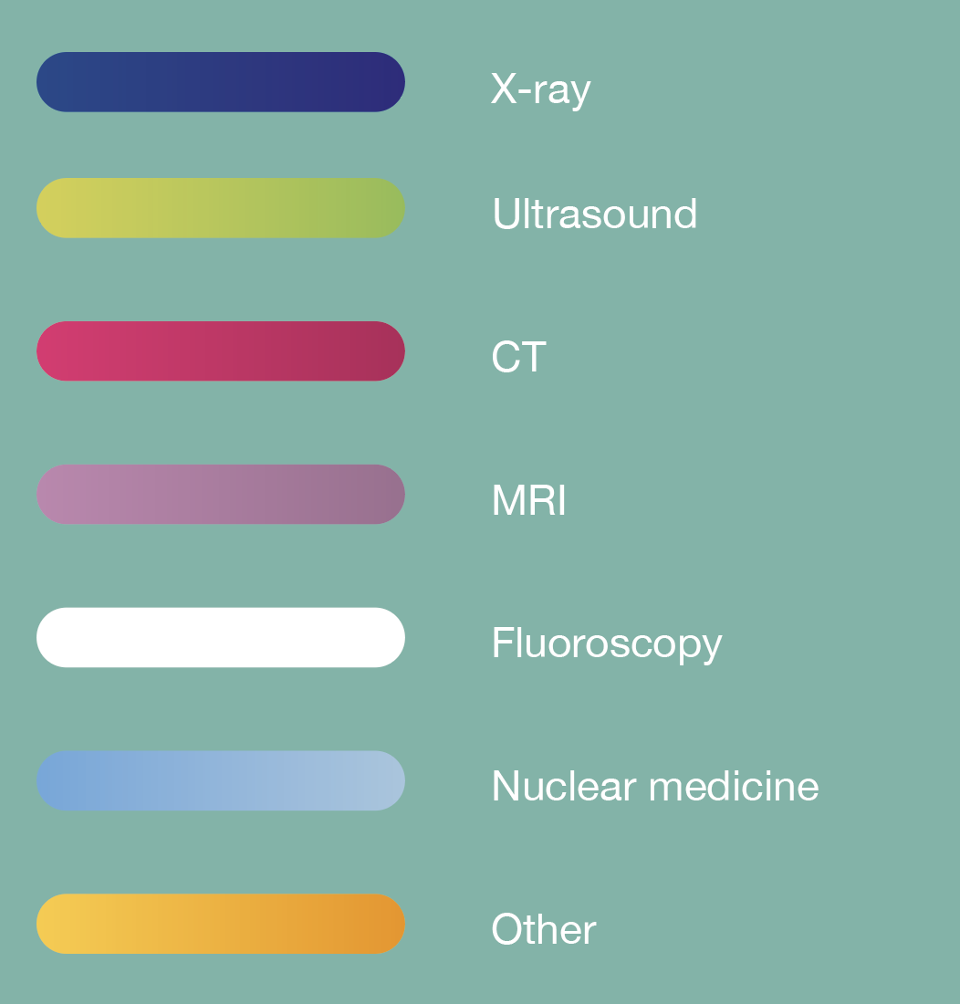
Average establishment WTE by modality - AfC bands 2 to 4 (support workforce)
Figure 8: Average establishment WTE by modality – AfC bands
2 to 4 support workforce
(n=49)
Agenda for Change band
Average establishment WTE
Figure 8

Slide 16
Average establishment WTE by modality - AfC bands 5 to 7
Figure 9: Average establishment WTE by modality – AfC bands 5 to 7 (n=49)
Agenda for Change band
Average establishment WTE
Figure 9

Slide 17
Average establishment WTE by modality - AfC bands 8, 9 and N/A
Figures 8 to 10 show the data from Figure 7 broken down by AfC band and indicating where an AfC band is not applicable (N/A) to the role. The majority of band 5 practitioners are employed in X-ray. The other modalities, with the exception of ultrasound, experience growth within band 6. The majority of ultrasound practitioners hold positions at band 7.
Figure 10: Average establishment WTE by modality – AfC bands 8, 9 and N/A (n=49)
Agenda for Change band
Average establishment WTE
Figure 10

Slide 18
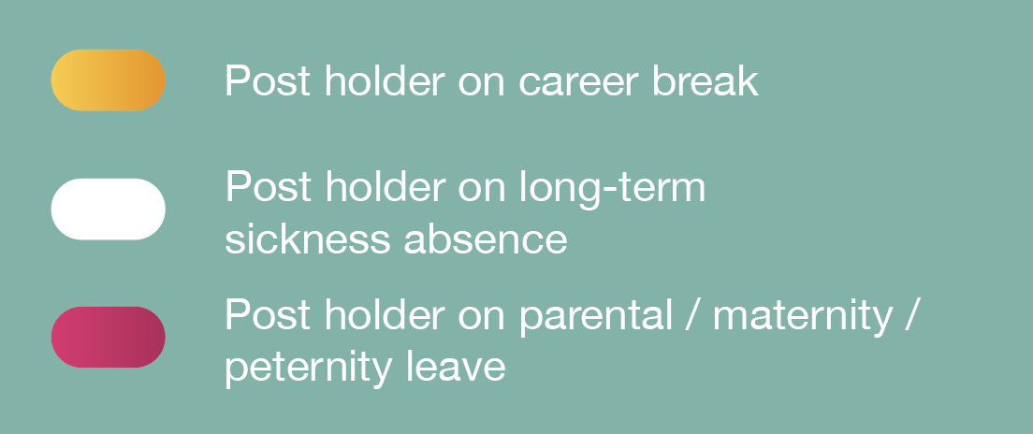
Long-term absence by Agenda for Change band
7
Long-term absence rate
7.1
Long-term absence rate by AfC band
Agenda for Change band
The average percentage of census respondents’ diagnostic radiography establishment headcount absent long term was 5.7% on the 1 November 2022 census date. This comprised 0.4% of the headcount who were on a career break, 2.6% who were absent due to long-term sickness and 2.7% who were on parental leave (both maternity and paternity). This is shown in Figure 11, with long-term absences broken down by AfC band.
Figure 11: Long-term absence
rates by AfC band (n=44)
Long-term absence as a percentage of establishment headcount
Figure 11

Slide 19

Long-term absence rate by year
7.2
Long-term absence rate by year
The average percentage of postholders absent due to long-term sickness rose from 1.6% to 2.6% between 2019 and 2022, as illustrated in Figure 12. This is the primary factor behind the total long-term absence rate increasing from 4.1% to 5.7% over the same period. In the 2021 census sickness absence was divided into absence relating to Covid-19 and absence not related to Covid-19.
Figure 12: Long-term absence rate by year (n=44)
Number of postholders on long-term absence as
a percentage of establishment headcount
Figure 12

Slide 20

Long-term absence rate by sector
7.3
Long-term absence rate by sector
NHS respondents to the 2022 census reported a higher long-term absence rate (6.1%) than non-NHS respondents (5.7%), mainly due to differences in the long-term sickness absence rate (2.9% versus 2.6%) and parental leave absence rate (2.8% versus 2.7%). These NHS and non-NHS sector differences are shown in Figure 13.
Figure 13: Long-term absence
rate by sector (n=44)
Number of postholders on long-term absence as
a percentage of establishment headcount
Figure 13

Slide 21

Postholder aged 60 years or above by AfC band and sector
8
Age by AfC band and sector
Respondents were asked to give the number of their diagnostic radiography workforce posts held by someone aged 60 years or above at the time of the census in November 2022. Respondents told us that the overall percentage of their workforce aged 60 and over is 4.7%. Among NHS providers the percentage is 4.9% and for non-NHS providers it is 4.3%. This is shown in Figure 14.
Figure14: Postholders aged 60 years or above by AfC band and sector
(n=43)
Agenda for Change band
Postholders as a percentage of establishment headcount
Figure 14

Slide 22

Diagnostic radiography workforce turnover (NHS and non-NHS)
9
Leavers
9.1
Turnover
Respondents were asked for the number of diagnostic radiography workforce posts where the postholder had left since the previous census date (1 November 2021). We used these responses to calculate percentage turnover. This is defined as follows:
Turnover = 100 x Number of
leavers in previous 12-month
period (headcount)
Establishment headcount
The average turnover among the 25 NHS and non-NHS providers who responded to this question is 10.2%. Figure 15 breaks this down by AfC band and leaver type; the highest turnover rates are seen at AfC bands 2 and 5.
Figure 15: Diagnostic radiography workforce turnover by AfC band (n=25)
Agenda for Change band
Postholders leaving in year as a percentage of establishment headcount
Figure 15

Slide 23
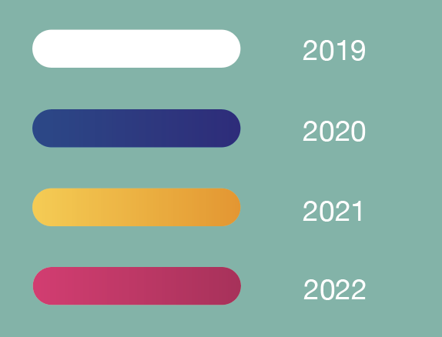
Reasons for leaving by year
9.2
Reasons for leaving
Respondents gave career development within another NHS imaging department and retirement as the main reasons why postholders had left their organisations. The percentage of postholders leaving their positions for higher salary opportunities elsewhere has notably increased, rising from 19% in 2019 to 43% in 2022. The range of reasons given is illustrated in Figure 16.
Figure 16: Reasons for postholders
leaving respondents’ organisations
by census year (n=44)
Percentage of respondents giving reason
Figure 16

Slide 24

International recruitment during previous year
and planned for coming year (NHS and non-NHS)
10
International recruitment
Respondents were asked the number of diagnostic radiography workforce posts who have been or planned to recruit internationally. Overall, respondents had recruited 8.1% of their headcount internationally during the past year (to 1 November 2022) and intended to recruit a further 7.5% in the coming year.
This international recruitment drive remains largely centred on AfC bands 5, 6 and 7. By headcount, 14% of band 5 staff had been recruited internationally over the past year and respondents planned to recruit a further 18% internationally throughout the coming year.
This demonstrates an increase in international recruitment figures. Between 2020 and 2021, 4.1% of respondents’ headcount was recruited internationally and a further 4.1% was planned between 2021 and 2022. This is illustrated in Figure 17 by AfC band among both NHS and non-NHS providers.
Figure 17: International recruitment during previous year and planned for coming year by AfC band (n=42)
Percentage of respondents giving reason
Long-term absence as a percentage of headcount in post
Figure 17

Slide 25
Average apprenticeship role headcount
11
Apprenticeships
(NHS England)
The fifteen NHS respondents to this question report that on average 5.5 posts are apprenticeships (by headcount). This is an increase from the previous year’s census data, which reported an average of 2.8 apprenticeship posts (by headcount). As shown in Figure 18, the highest headcounts are in diagnostic radiography integrated degree apprenticeships (2.9) followed by healthcare assistant practitioner apprenticeships (1.4).
Figure 18: Average number of apprenticeships per NHS respondent in England (n=15)
Figure 18

Slide 26

12
Return
to practice
Two (12.5%) of the 16 respondents to the census question on return to practice said they had supported a return to practice in the year up to the November 2022 census date.

Slide 27

Band 5 or higher clinical staff not registered with
HCPC, NMC, RCT or similar
13
Registration status of band 5 or higher clinical staff
Of the 42 respondents to the census question on individuals’ registration status, 11 (12.1%) reported having band 5 or higher clinical staff not registered with the Health and Care Professions Council (HCPC), Nursing and Midwifery Council (NMC), Register of Clinical Technologists (RCT) or a similar body. Respondents who also answered the headcount question said that 2.2% (by headcount) of band 5 or higher clinical staff are not registered with such bodies. Figure 19 shows this percentage is 0.8% for NHS respondents and 11.1% for non-NHS respondents, although these values are dominated by two large providers.
Figure 19: Band 5 or higher clinical staff not registered with HCPC,
NMC, RCT or similar
body by sector (n=42)
Percentage
Figure 19

Slide 28
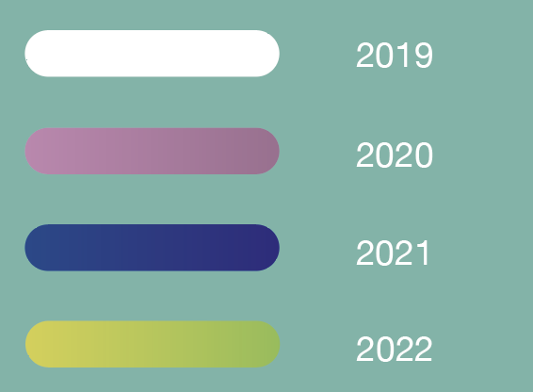
Estimated percentage of time spent on supporting professional activities
by Agenda for Change band and census year
14
Supporting professional activities
Respondents were asked to roughly estimate the percentage of time staff at AfC band 7 (or equivalent) and above spend on supporting professional activities in an average working week. These activities underpin the delivery of imaging services but are not directly patient-facing. They can relate to leadership, management, picture archiving and computer systems (PACS), quality improvement, quality management, the Quality Standard for Imaging (QSI), research, service development, training and development.
Respondents reported that 35% of time at band 7 is spent on supporting professional activities. This activity peaks to 58% at band 8a then returns to about 35% at band 8b and 8c, as shown in Figure 20. The smaller number of respondents with posts at 8d and above means calculations are more easily affected by small differences year to year and should be treated with caution.
Figure 20: Estimated percentage of time spent on supporting professional activities by AfC band and census year (n=40)
Average estimated percentage of time
Agenda for Change band
Figure 20

Slide 29
Estimated percentage of time spent on supporting professional activities
by Agenda for Change band and sector
Respondents report that individuals at bands 7, 8b and 8c spend broadly the same proportion of their time on supporting professional activities irrespective of sector, as illustrated in Figure 21. However, non-NHS respondents report individuals at band 7 spend an estimated 10% of their time on average on supporting professional activities compared with 39% in the NHS.
Figure 21: Estimated percentage of time spent on supporting
professional activities by AfC band and sector (n=40)
Average estimated percentage of time
Agenda for Change band
Figure 21

Slide 30
Percentage of staff in postgraduate training by modality
15
Postgraduate training
Respondents were asked the number of staff (headcount) currently in postgraduate training in a set of given modalities. Overall, 5.53% of the headcount are in postgraduate training in one of these modalities, as shown in Figure 22, with all but 19 these staff employed by NHS providers. The three non-NHS respondents to this question reported that among their staff a total of 19 individuals are in postgraduate training, studying leadership development or mammography or for a PgCert/PgDip/master’s qualification in CT or MRI.
Figure 22: Percentage of staff (headcount) in postgraduate
training by modality and sector (n=42)
Respondents also mentioned other members of staff in postgraduate training who are not included in the data illustrated in Figure 22. Among these were three individuals doing an MSc dissertation on medical ultrasound, a clinical research fellow and two trainee assistant practitioners.
Postgraduate modality
Number of postholders currently in postgraduate training in the modality
as a percentage of establishment headcount
Figure 22

Slide 31
Number of workers at band 2, 3 or 4 as a
percentage of establishment by sector
16
Support
workforce
On average, each census respondent has 22 diagnostic radiography workforce members (headcount) at bands 2, 3 or 4 (referred to here as support workers). This represents 23.2% of headcount. The 47 NHS respondents to the headcount question reported that support workers make up 22.3% of headcount compared with the 12 non-NHS respondents reporting 28.7%. Figure 23 shows the percentages are slightly lower when calculated by WTE, suggesting that support workers are more likely to work part-time.
Figure 23: Number of support workers as a percentage of establishment by sector
(n=59)
Numbers at band 2, 3 or 4 as a percentage of establishment
Figure 23

Slide 32
Number of practitioners in advanced and consultant-level practice
as a percentage of establishment headcount by sector
17
Advanced and consultant
On average, each respondent has 8.5% diagnostic radiography workforce members (headcount) carrying out advanced practice and 0.8% carrying out consultant-level practice, as shown in Figure 24. The 47 NHS respondents to this question reported that advanced practitioners make up 9.6% of headcount compared with the 2.9% of headcount reported by the 12 non-NHS respondents, who also have 0.1% consultant practitioners.
Figure 24: Number of practitioners
in advanced and consultant-level
practice as a percentage of establishment headcount by sector
(n=59)
Number of practitioners as a percentage of establishment headcount
Figure 24

Slide 33
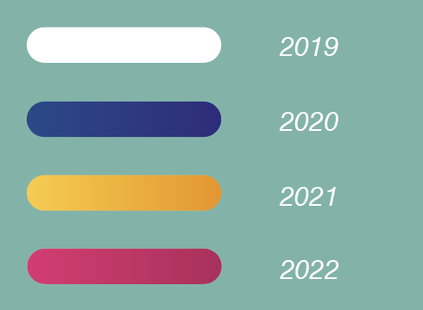
Employment of agency staff by year
18
Agency staff
Of the 42 respondents to census questions on their use of agency staff, 32 (76%) were using either diagnostic radiography or sonography agency staff (or both) on the November 2022 census date. This number has been steady at around 80% since 2020, as shown in Figure 25.
Figure 25: Percentage of providers using agency diagnostic radiography or sonography staff, by census year
Percentage of respondents employing agency staff
Discipline
Figure 25

Slide 34
Further documents relating to the 2022 census can be accessed from:
19
Downloads
https://www.sor.org/learning-advice/professional-body-guidance-and-publications/documents-and-publications/reports-and-surveys
2022 SoR diagnostic radiography workforce UK census questionnaire (PDF)
2022 SoR diagnostic radiography workforce UK census spreadsheet (Excel)

Slide 35
The Society and College of Radiographers (2020). Diagnostic Radiography Workforce UK Census 2019, Available at: https://www.sor.org/learning-advice/professional-body-guidance-and-publications/documents-and-publications/reports-and-surveys/diagnostic-radiography-workforce-uk-census-2019 [Accessed July 12, 2022].
The College of Radiographers (2021). Diagnostic Radiography Workforce UK Census 2020, Available at: https://www.sor.org/learning-advice/professional-body-guidance-and-publications/documents-and-publications/reports-and-surveys/or-diagnostic-radiography-workforce-uk-census-2020 [Accessed July 12, 2022].
The College of Radiographers (2022). Diagnostic Radiography Workforce 2021 UK Census, Available at: https://www.sor.org/learning-advice/professional-body-guidance-and-publications/documents-and-publications/reports-and-surveys/cor-diagnostic-radiography-workforce-census-2021 [Accessed July 12, 2022].
20
References

Slide 36
Diagnostic Radiography
Workforce UK Census
2022
207 Providence Square,
Mill Street, London SE1 2EW
www.sor.org

